Slide 1
Chapter 7
What Should I Know about the Sizes and Speeds of Computers?

Slide 2
Gordon Moore
Observed that integrated circuit doubled in density every year from 1959 to 1965
Predicted the same would occur for another 10 years
Has been approximately correct, though tread has slowed
An observation, not a physical law

Slide 3
Memory
Follows a similar curve, doubling every ~2 years
Disks increased at ~50% a year

Slide 4
Bugs
Intel CEO Brian Krzanich explained that if a 1971 Volkswagen Beetle had advanced at the pace of Moore’s law over the past 34 years, today “you would be able to go with that car 300,000 miles per hour. You would get two million miles per gallon of gas, and all that for the mere cost of four cents.”
Notes:
http://www.scientificamerican.com/article/moore-s-law-keeps-going-defying-expectations/

Slide 5
Limits
We appear to be approaching the limits
CPU clock speeds leveling off
I/O, memory, spinning disk speed constrain systems
Motivate move to multi-core
Move parallel tasks to different cores
Off-load CPU

Slide 6
GPU
One approach is graphical processing units
First off-loaded CPU from graphical tasks
Now have hundreds or thousands of more general purpose processors
Virtual reality and games have driven capabilities
GPUs now used to process audio, video, scientific computing, weather forecasting, encryption, etc.

Slide 7
Trend
Special purpose hardware becomes more general purpose
Happened with original computers
But there are still limits

Slide 8
Corn
Chess board
1 kernel of corn in first square
2 in second
4 in third…
2^{n}
Last square = 2⁶³ = 9,223,372,036,854,775,808
Total = 18,446,744,073,709,551,615

Slide 9
Corn
Bushels = 253,389,341,671,834
World’s total ~= 17,700,000,000 bushels a year
Years = 14,315

Slide 10
Exponential
Some problems are too big for modern computers
Some are very easy

Slide 11
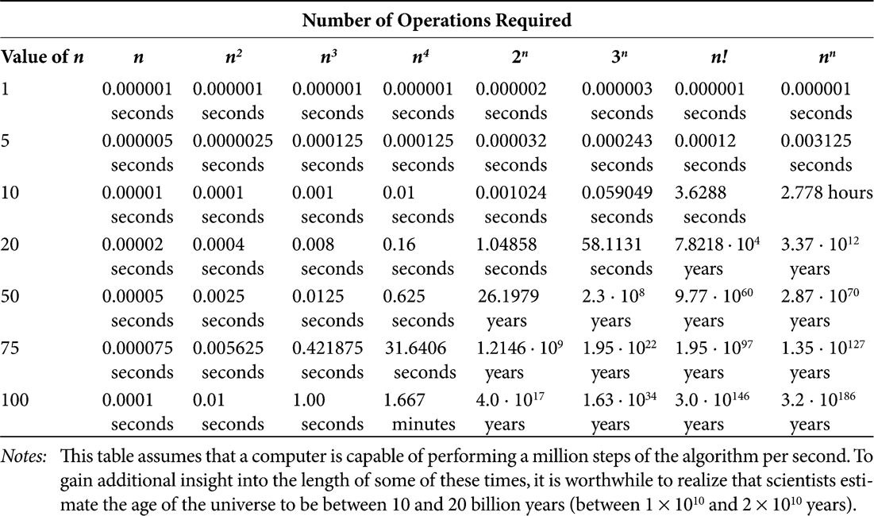
Complexity

Slide 12
Travelling Salesperson Problem
Start at one city
Visit some other cities
Each only once
Follow roads or airline routes
With variable costs

Slide 13
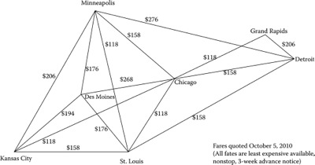
Example

Slide 14
Routes
There are routes that goes through each city only once
One can enumerate them all
“Exhaustive search”
Permutaitons

Slide 15
Routes
Starting at any city, there are n-1 cities to visit next
At the second city, there are n-2 cities to visit next
And so on
(n-1)*(n-2)*(n-3)*…*3*2*1
(n-1)!

Slide 16
Cities
With 10, ~3 seconds
With 20, 70,000+ years

Slide 17
How Difficult?
Polynomial or not?
Order n, n², n³, etc.
Class P(olynomial)
Order 2^{n}, n^{n}, n!, etc.
Class NP
Non-deterministic Polynomial

Slide 18
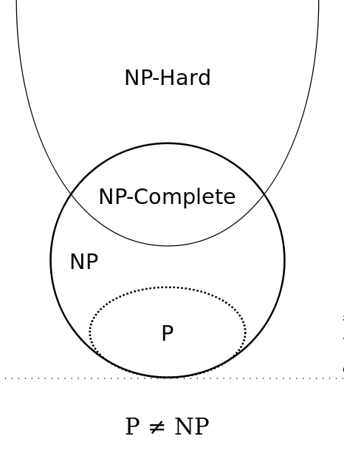
Euler Diagram

Slide 19
NP
NP -- class of computational problems for which a given solution can be verified as a solution in polynomial time by a deterministic Turing machine.
NP-hard -- class of problems which are at least as hard as the hardest problems in NP. Problems that are NP-hard do not have to be elements of NP; indeed, they may not even be decidable.
NP-complete -- class of problems which contains the hardest problems in NP. Each NP-complete problem has to be in NP.

Slide 20
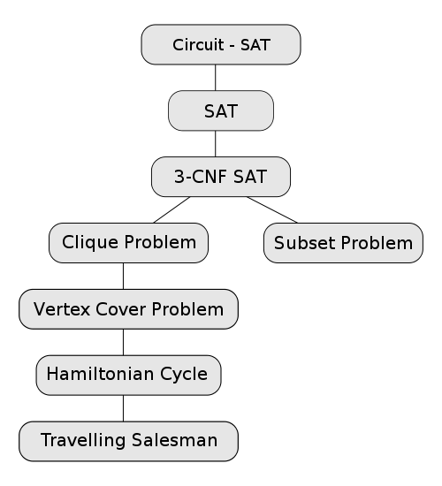
NP-Complete
Notes:
https://en.wikipedia.org/wiki/NP-complete

Slide 21
P == NP?
Hasn’t been proven
NP includes all P

Slide 22
Playing Chess
Generate all possible moves and evaluate
For the best moves, look at what opponent would do
A ply is one move
Two plies are you and the opponent moving
Each ply has ~20 possible moves
As does the response

Slide 23
Playing Chess
2 plies = 20 * 20 = 400 possibilities to evaluate
3 plies = 8000
20^{ply}
Typical game = ~50 moves
112,589,990,684,262,400,000,000,000,000,000,000,000,000,000,000,000,000,000,000,000,000 moves to evaluate
Take longer than the age of the universe

Slide 24
So, What do we do?
Approximate
Lots of good ways to approximate
TSP: no crossed lines
Chess: 12 plies and knowledge of board positions

Slide 25
Not Optimal
Computers haven’t scaled up to problem size
Even though scaled very quickly
Factor of two doesn’t help enough
20x ~= 16x which take ~8 years
One more ply a decade

Slide 26
Logical Complexity
Not all complexity in problem itself
We are now solving problems that no one person can understand the solution
The solutions to small problems is not the same as solutions to large problems
More than multiplicative
New features add complexity
And bugs

Slide 27
Types of More
Features
Speed
Graphics
Accuracy
All have associated costs

Slide 28
Space Shuttle
1989
500,000 lines
$500,000,000
$1,000 per line
In four years, 4,000 changes
Three a day

Slide 29
Ground Software
Similar amount of lines
Testing
Three critical, 76 major, 128 minor
Mission
One critical, three major, 20 minor

Slide 30
Still…
Saved money and schedule
Couldn’t do without
Too little computer, budget, schedule, …

Slide 31
Troubles
New software add features but must support older features
New features add bugs of their own of course
Fixing bug has ripple effect
Sometimes might choose to not fix bug due to unknown effects
Some users choose to wait a bit after new release to allow others to find bugs

Slide 32
Speed
Increasing speed of one component may not have affect on overall performance
Faster CPU limited by I/O, etc.

Slide 33
Accuracy
When do you need accuracy?
Typically comes at reduced speed
Is a good approximation good enough?
E.g.: gallons of paint
How accurate is input?

Slide 34
Review
Questions: 4, 5, 7, 9, 10
Exercises: 1, 7, 9
Research: 1, 3

